Slide 1
To Our Presentation
1
Welcome

Slide 2
Introduction
2
Name | ID | Department | Semester | Section
Ananno Barua | 1703310201528 | CSE | 6th | 6C6
Aiyshore Chowdhury | 1703310201545 | CSE | 6th | 6C6

Slide 3
Project Name
3
Hate Speech Identification

Slide 4
Software & Language
4
Google Colab
Python

Slide 5
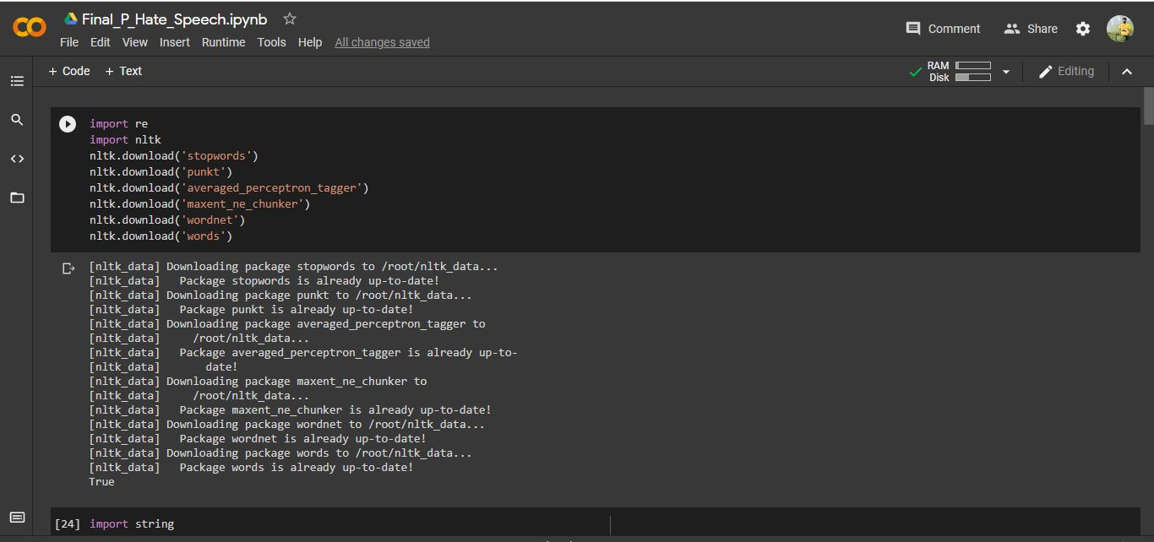
Import & Download
5

Slide 6
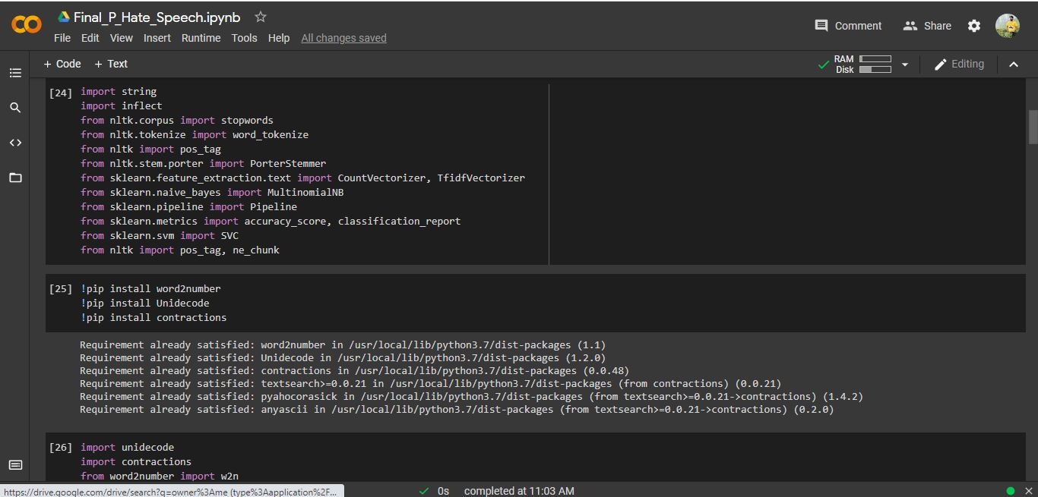
Import & Download
6

Slide 7
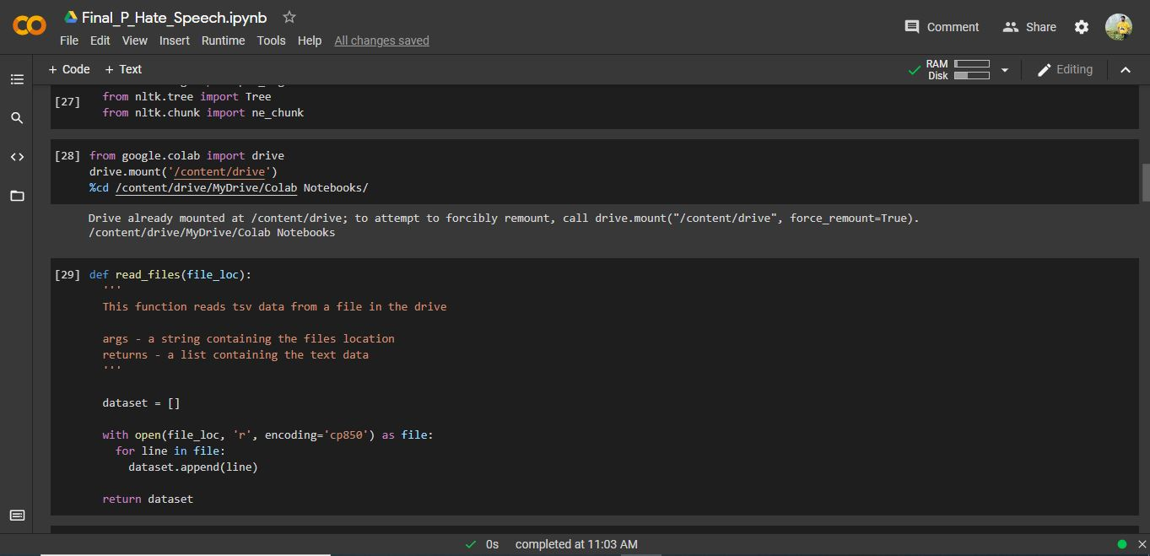
Import & Mount Google Drive
7

Slide 8
Implementing Functions
8

Slide 9
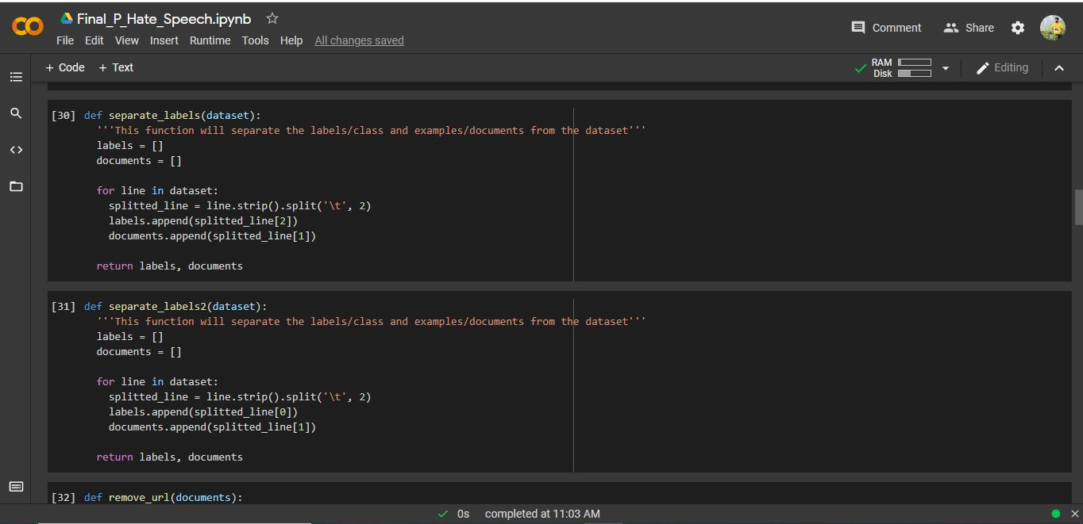
Implementing Functions
9

Slide 10
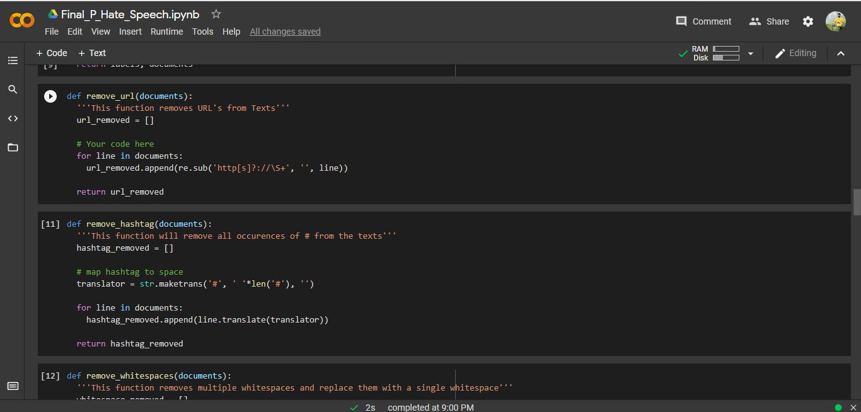
Pre-processing
10

Slide 11
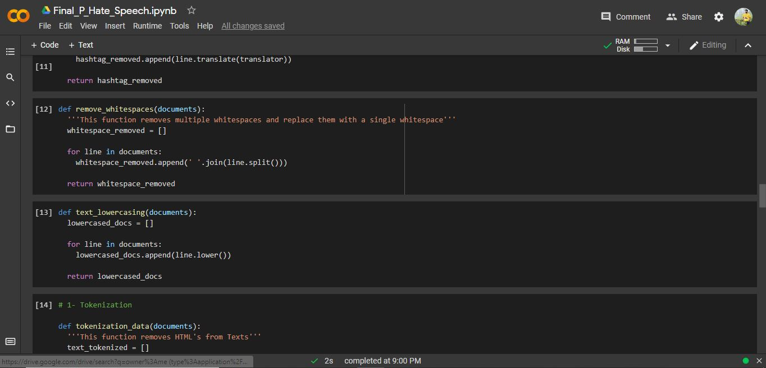
Pre-processing
11

Slide 12
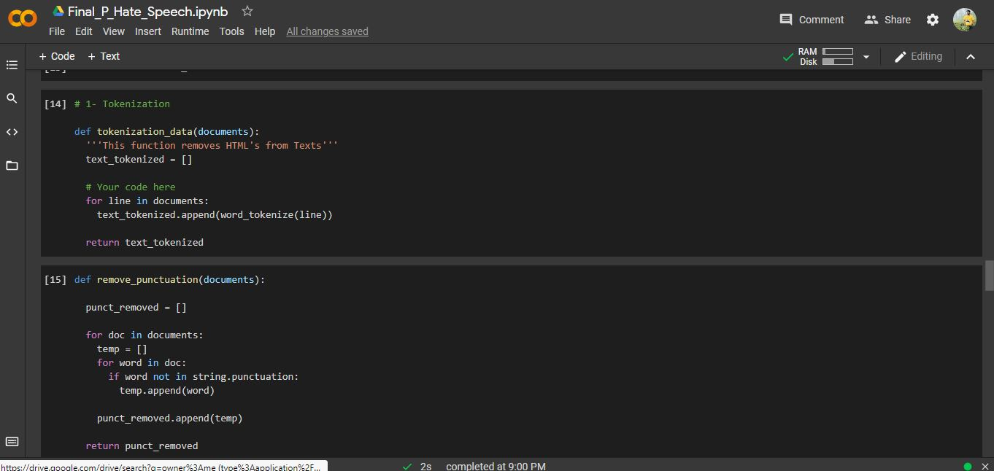
Pre-processing
12

Slide 13
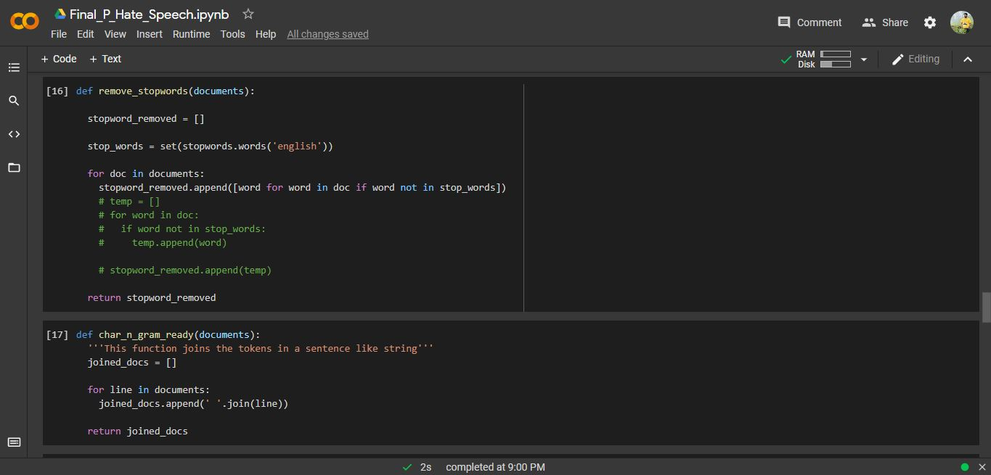
Pre-processing
13

Slide 14
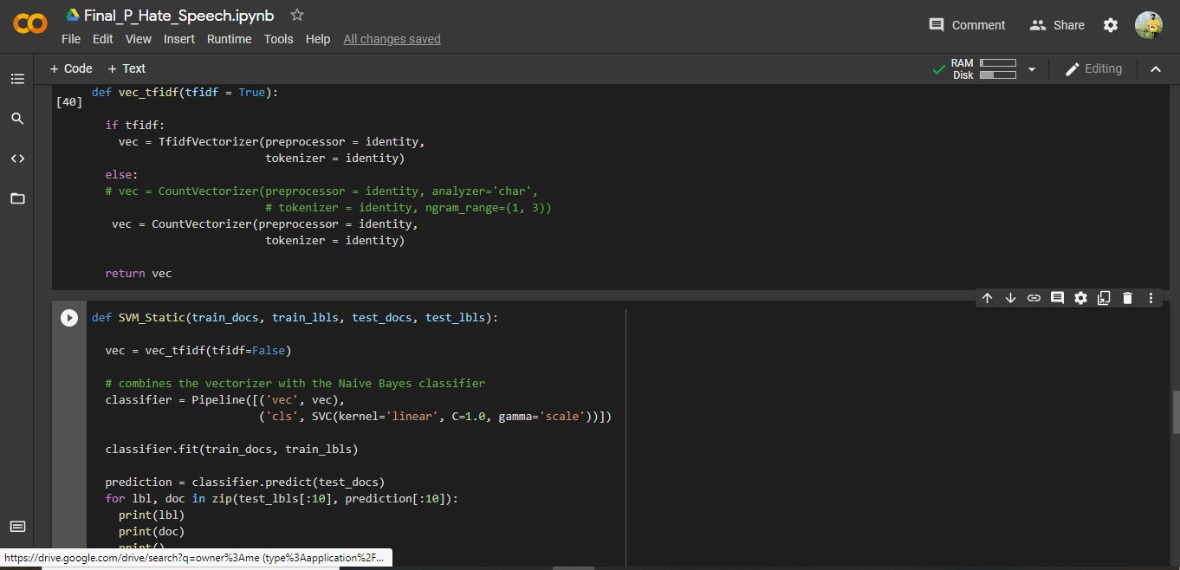
Pre-processing & SVM Feature
14

Slide 15
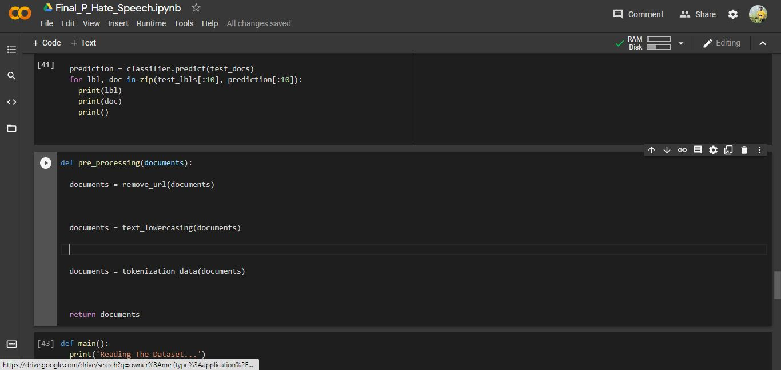
Pre-processing
15

Slide 16
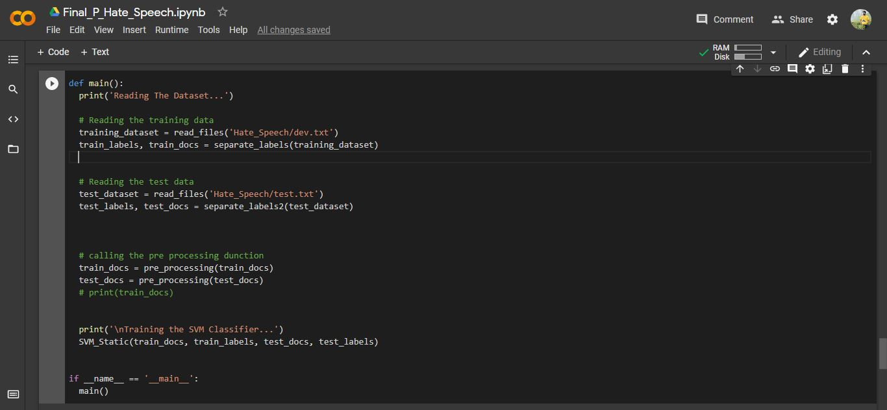
Main Function
16

Slide 17
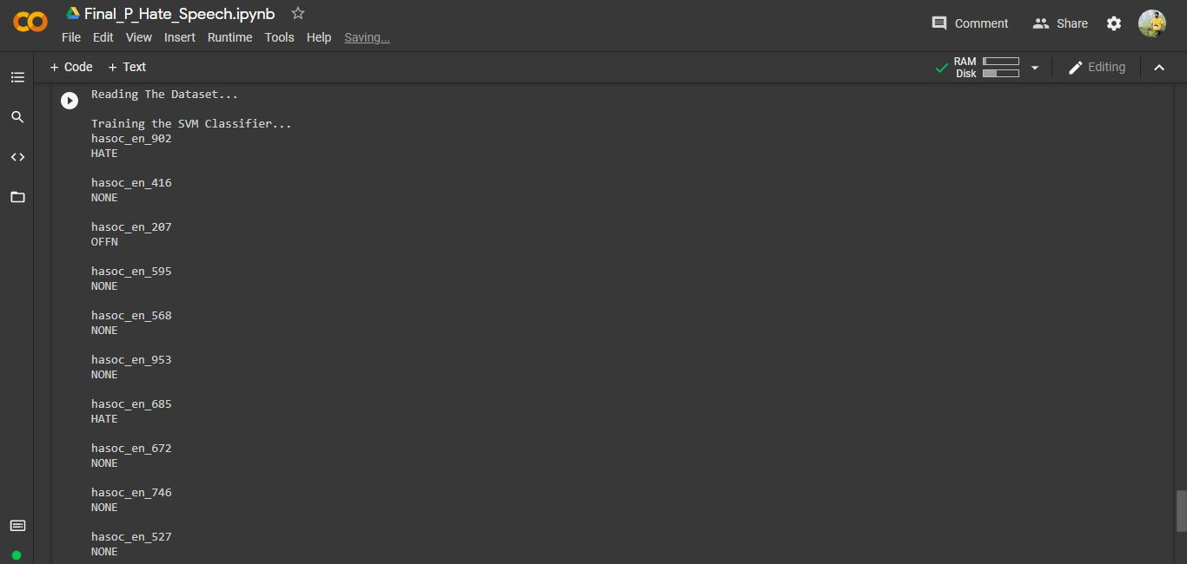
Output
17

Slide 18


